Slide 1

Evaluation Parts
1) Introduction (ARP, ARP Poisoning, attack surface, attack vulnerabilities and attack anatomy)
2) Demonstration (bettercap application)
3) Attack score (Attack Tree, Common Vulnerability Scoring System)
4) Prevention and Detection (HTTPS, VPN)

Slide 2
Group - 7
MITM ATTACK
USING ARP POISONING
TEAM MEMBERS:
Adarsh Singh (S20220010004)
Himanshu Saraswat (S20220010082)
DHARAWATH NAGESHWARI (S20220010061)
ASHWIN KUMAR NAIK NENAVATH (S20220010152)
ICS Project

Slide 3
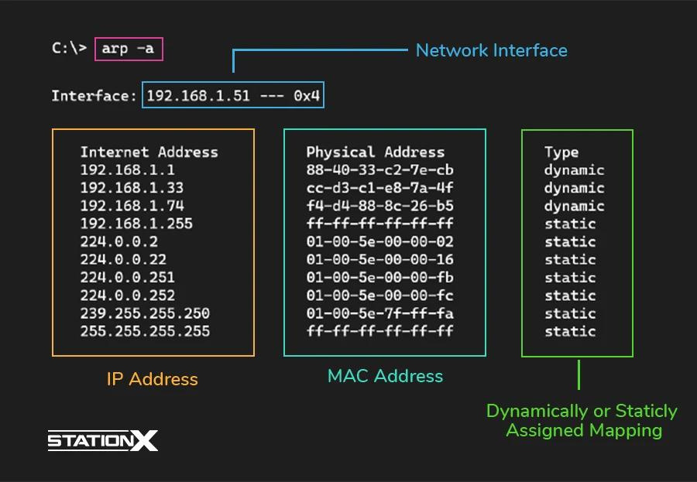
What is Address Resolution Protocol ?
Simple protocol used to map IP Address of a machine to its MAC address.

Slide 4
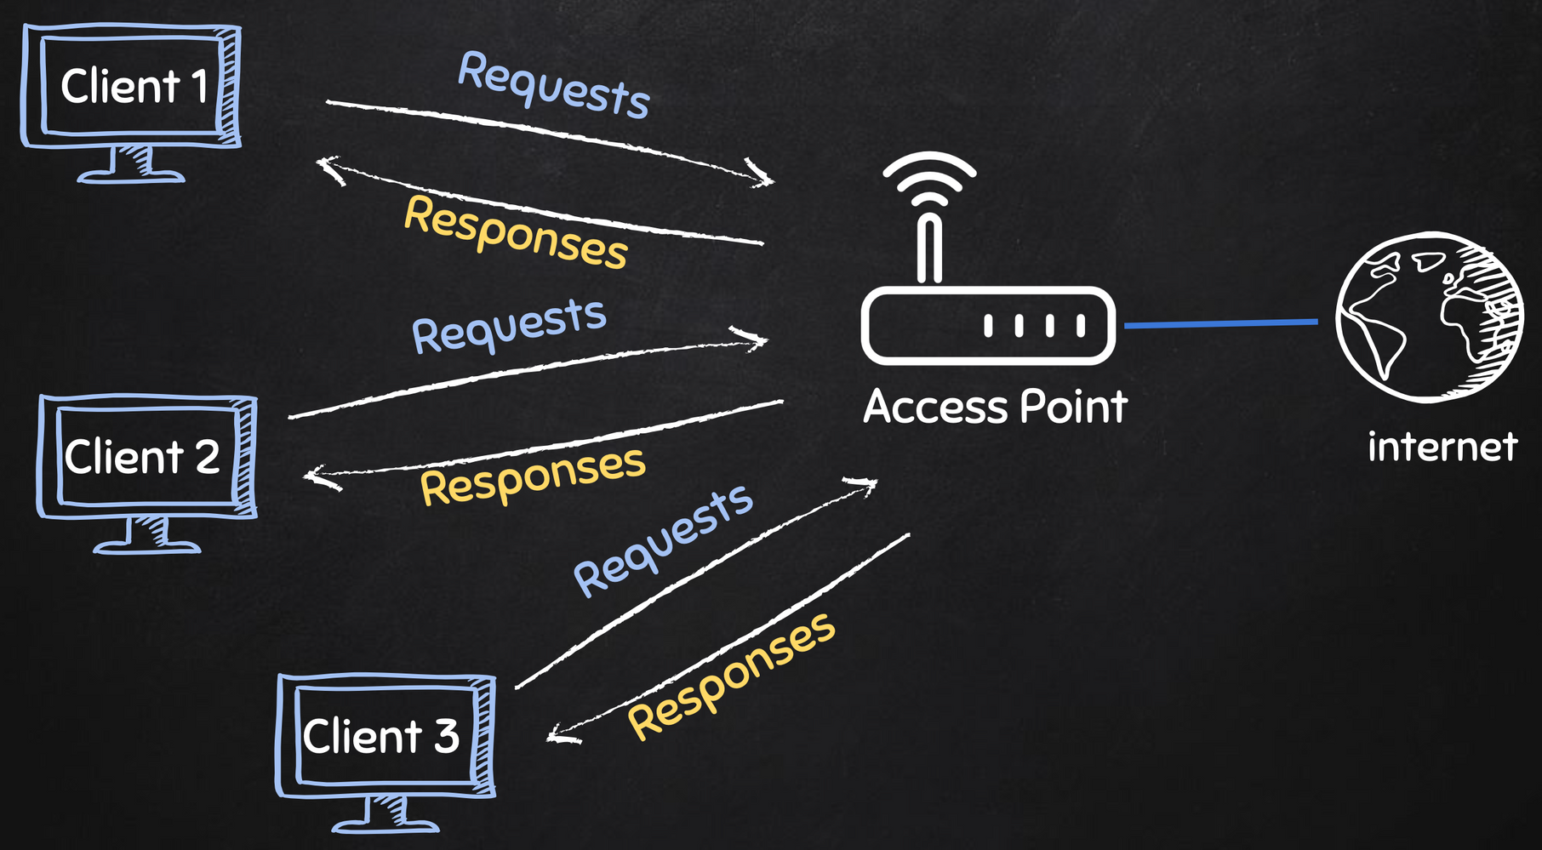




Typical Network

Slide 5


MITM Attacks

Slide 6

ARP Spoofing

Slide 7
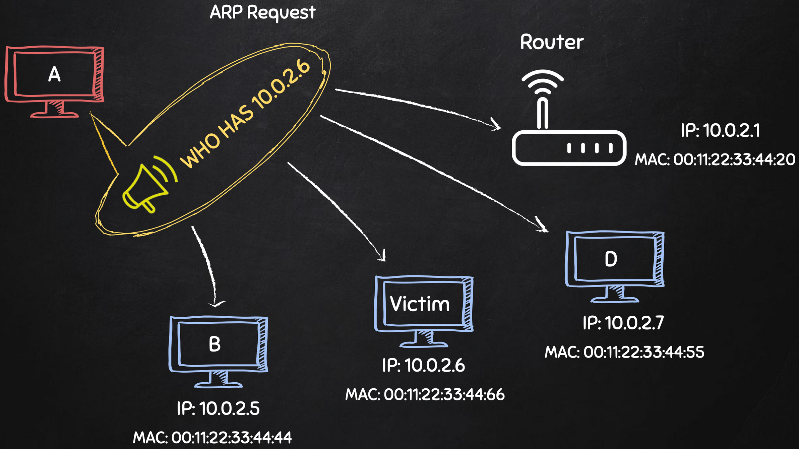

Slide 8
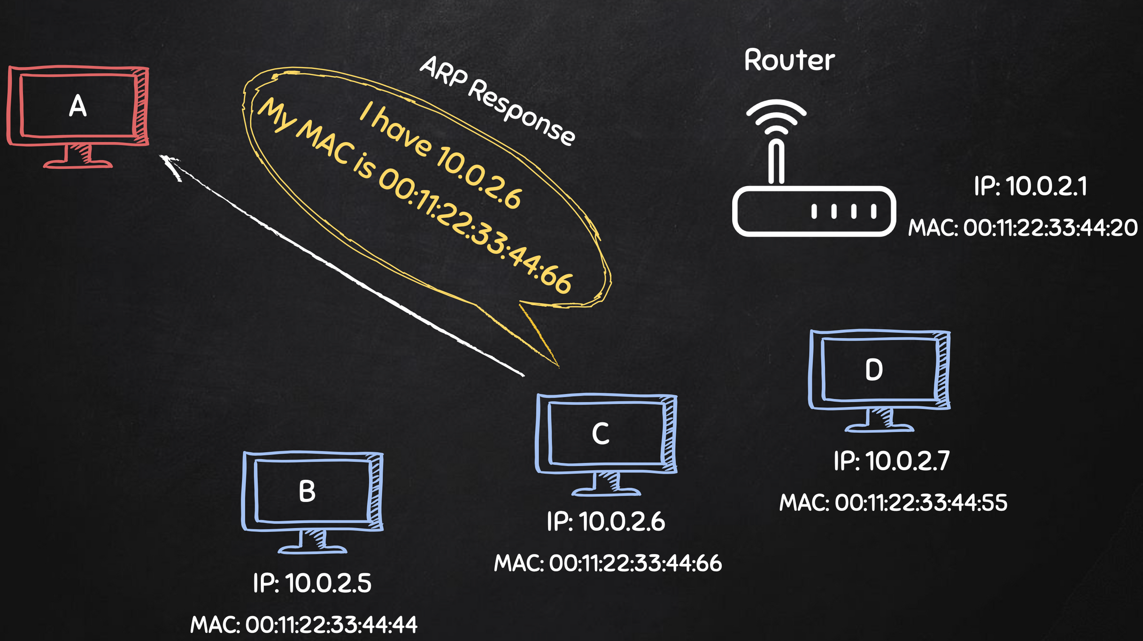

Slide 9
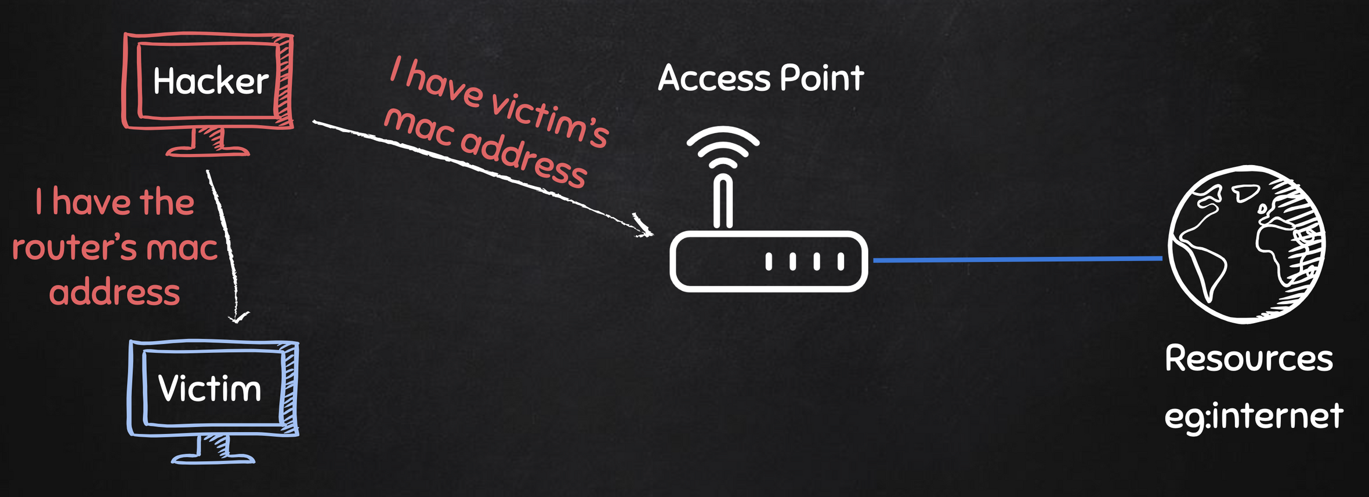
ARP Spoofing

Slide 10
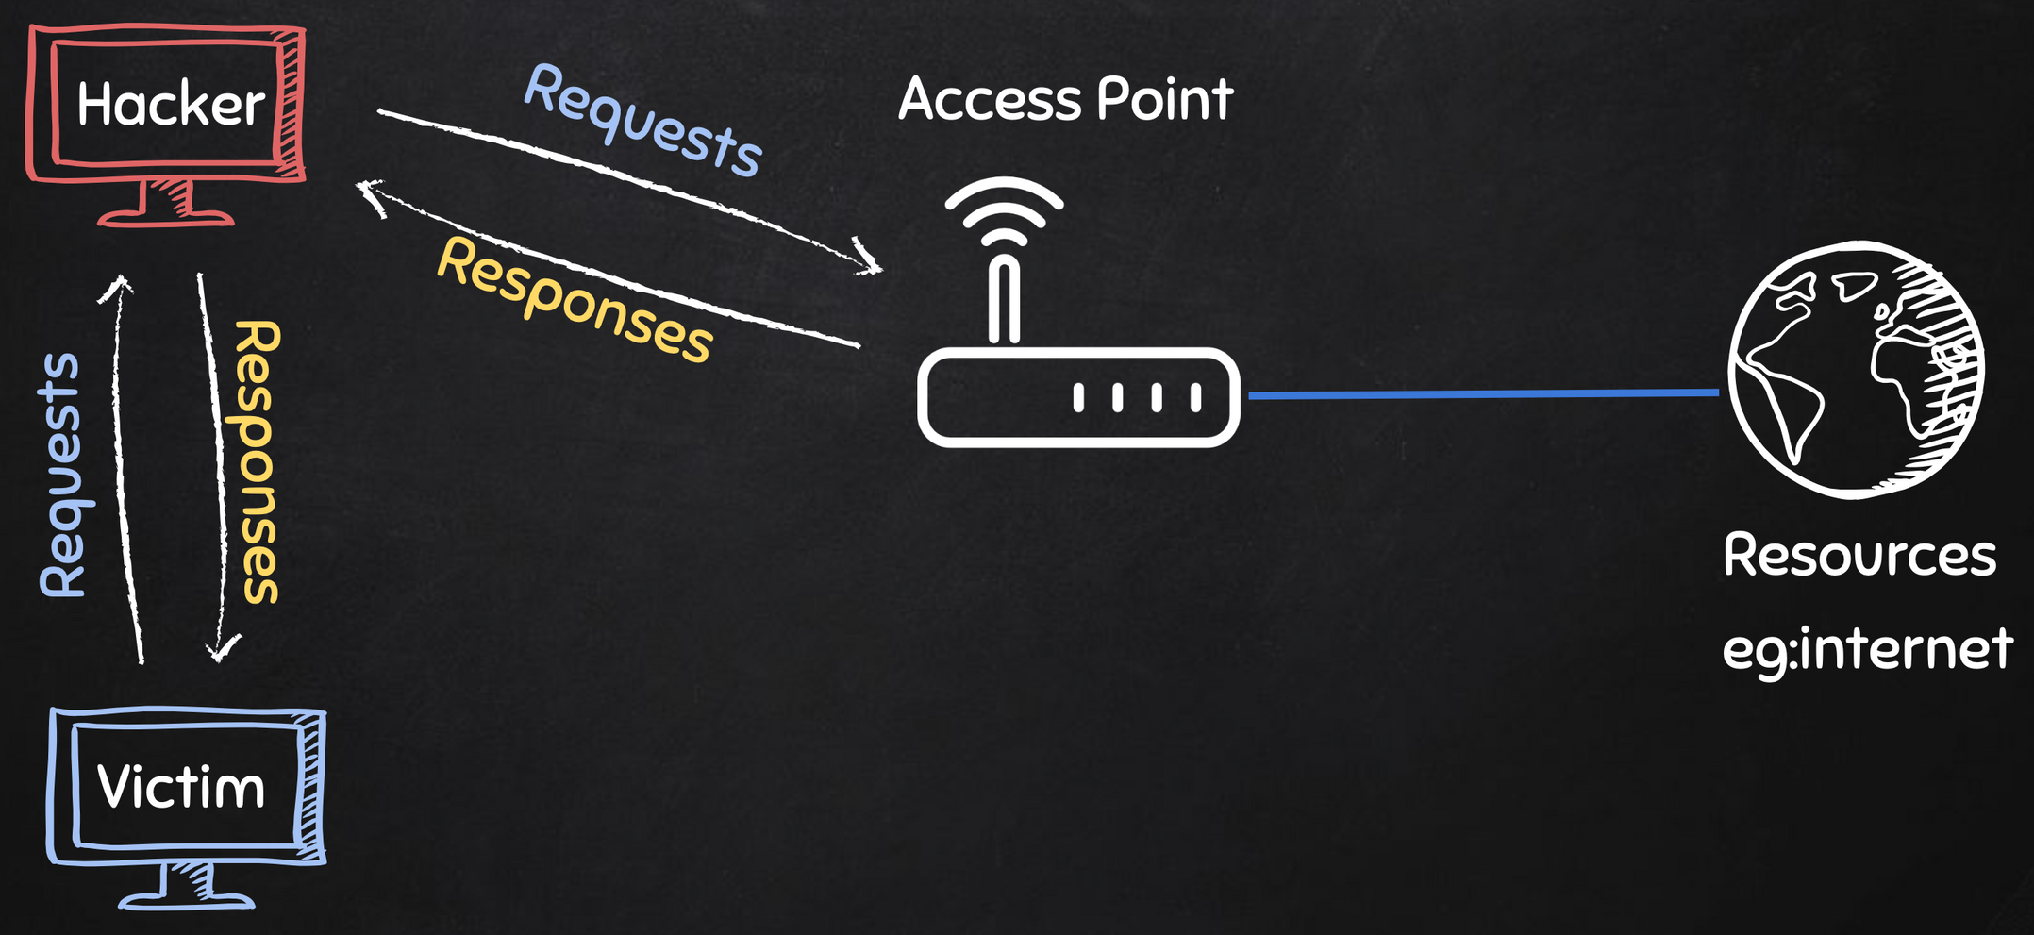
ARP Spoofing

Slide 11
MITM Attacks
Attack Surface : ARP spoofing
Attack Vulnerabilities : (ARP)
Stateless protocol: ARP operates without maintaining connection state.
Automatic caching: Hosts cache all ARP replies, solicited or unsolicited.
Overwriting entries: New ARP replies overwrite existing cache entries, even unexpired ones.
Lack of authentication: ARP has no mechanism to verify the origin of received packets.

Slide 12
MITM Attacks
Attack Anatomy :
Exploit lack of authentication: Send spoofed ARP messages on the LAN.
Associate attacker's MAC with target's IP: Trick network into sending target's traffic to attacker.
Intercept traffic: Receive packets intended for the target host.
Choose attack vector:
Spying: Inspect packets, then forward to actual destination.
Man-in-the-middle: Modify data before forwarding.
Denial-of-service: Drop some or all intercepted packets.
Maintain stealth: For spying or man-in-the-middle attacks, forward traffic to avoid detection.

Slide 13

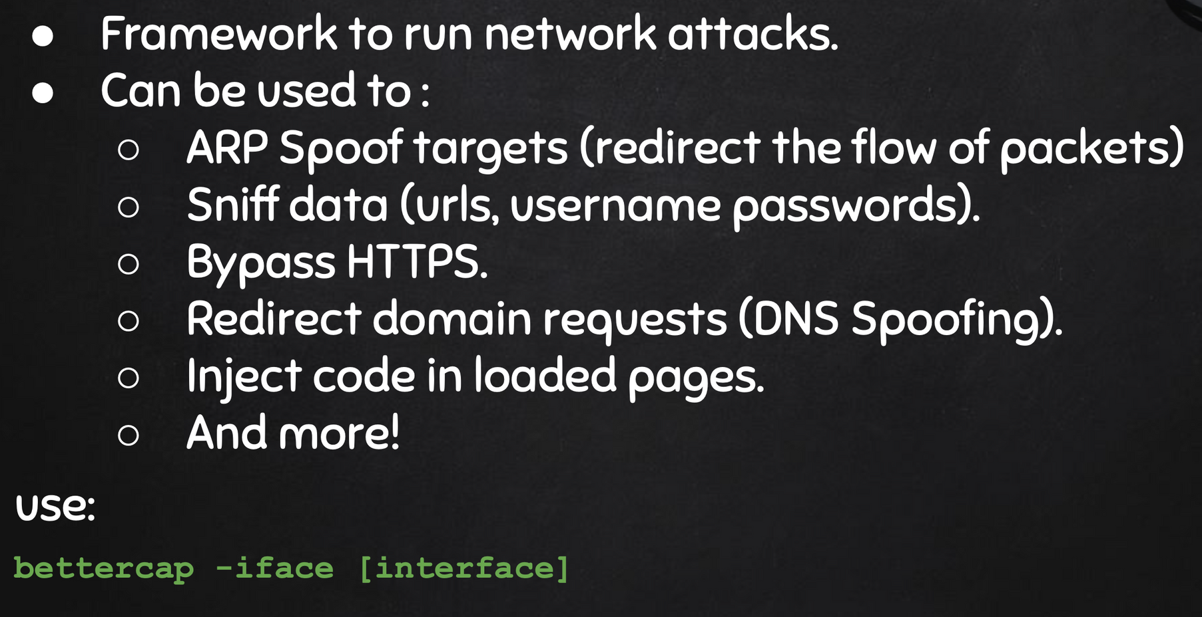
Demonstration
Using ButterCap

Slide 14
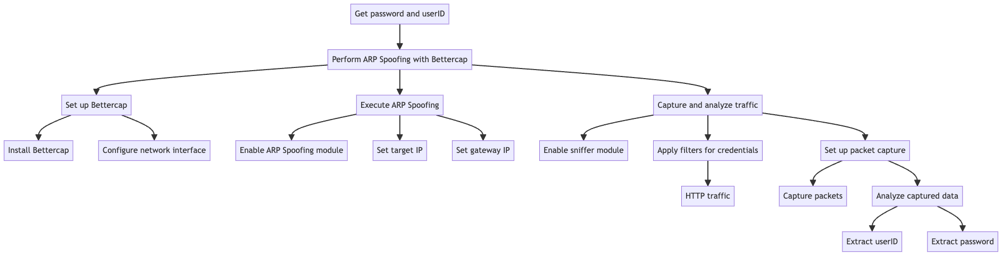
Attack Tree

Slide 15
Common Vulnerability Scoring System
Exploitability Metrics:
Attack Vector: Network (N)
The attack is executed over the local area network.
Attack Complexity: Low (L)
Relatively simple to perform with readily available tools.
Privileges Required: Low (L)
Only requires access to the local network, no special privileges needed.
User Interaction: None (N)
The attack can be carried out without any action from the target user.
Scope: Changed (C)
The attack impacts not just the targeted system but potentially all network traffic.

Slide 16
Common Vulnerability Scoring System
Impact Metrics:
Confidentiality: High (H)
Allows unauthorized access to potentially sensitive network traffic.
Enables eavesdropping on communications meant for the target.
Integrity: High (H)
Permits modification of intercepted data before forwarding.
Enables man-in-the-middle attacks, allowing alteration of transmitted information.
Availability: High (H)
Can be used to conduct denial-of-service attacks by dropping packets.
May disrupt normal network operations and access to resources.

Slide 17
MITM Attacks
Detection & Prevention
Detection:
Analysing arp tables: Flag sudden or unusual IP-to-MAC mapping changes
Multiple IP detection: Flags multiple IPs associated with a single MAC address
Identify Unsolicited Replies:
Look for ARP replies that don't have a matching request in recent traffic
Pay attention to replies sent to broadcast MAC address (ff:ff:ff:ff:ff:ff)
Wireshark: This open-source tool can be used to discover ARP spoofing in large network.

Slide 18
MITM Attacks
Detection & Prevention
Prevention:
Always use HTTPS (HTTP Secure): Encrypts data between your browser and the web server which Prevents attackers from reading or modifying transmitted data, even if they've successfully executed an ARP spoofing attack.
VPN (Virtual Private Network):
Encrypts all network traffic, not just web browsing
Creates a secure tunnel from your device to the VPN serve
Kernel-level prevention:
Tools like AntiARP for Windows
ArpStar module for Linux and some routers
Use Linksys routers: Drops invalid packets that violate mapping, and contains an option to repoison or heal.

Slide 19
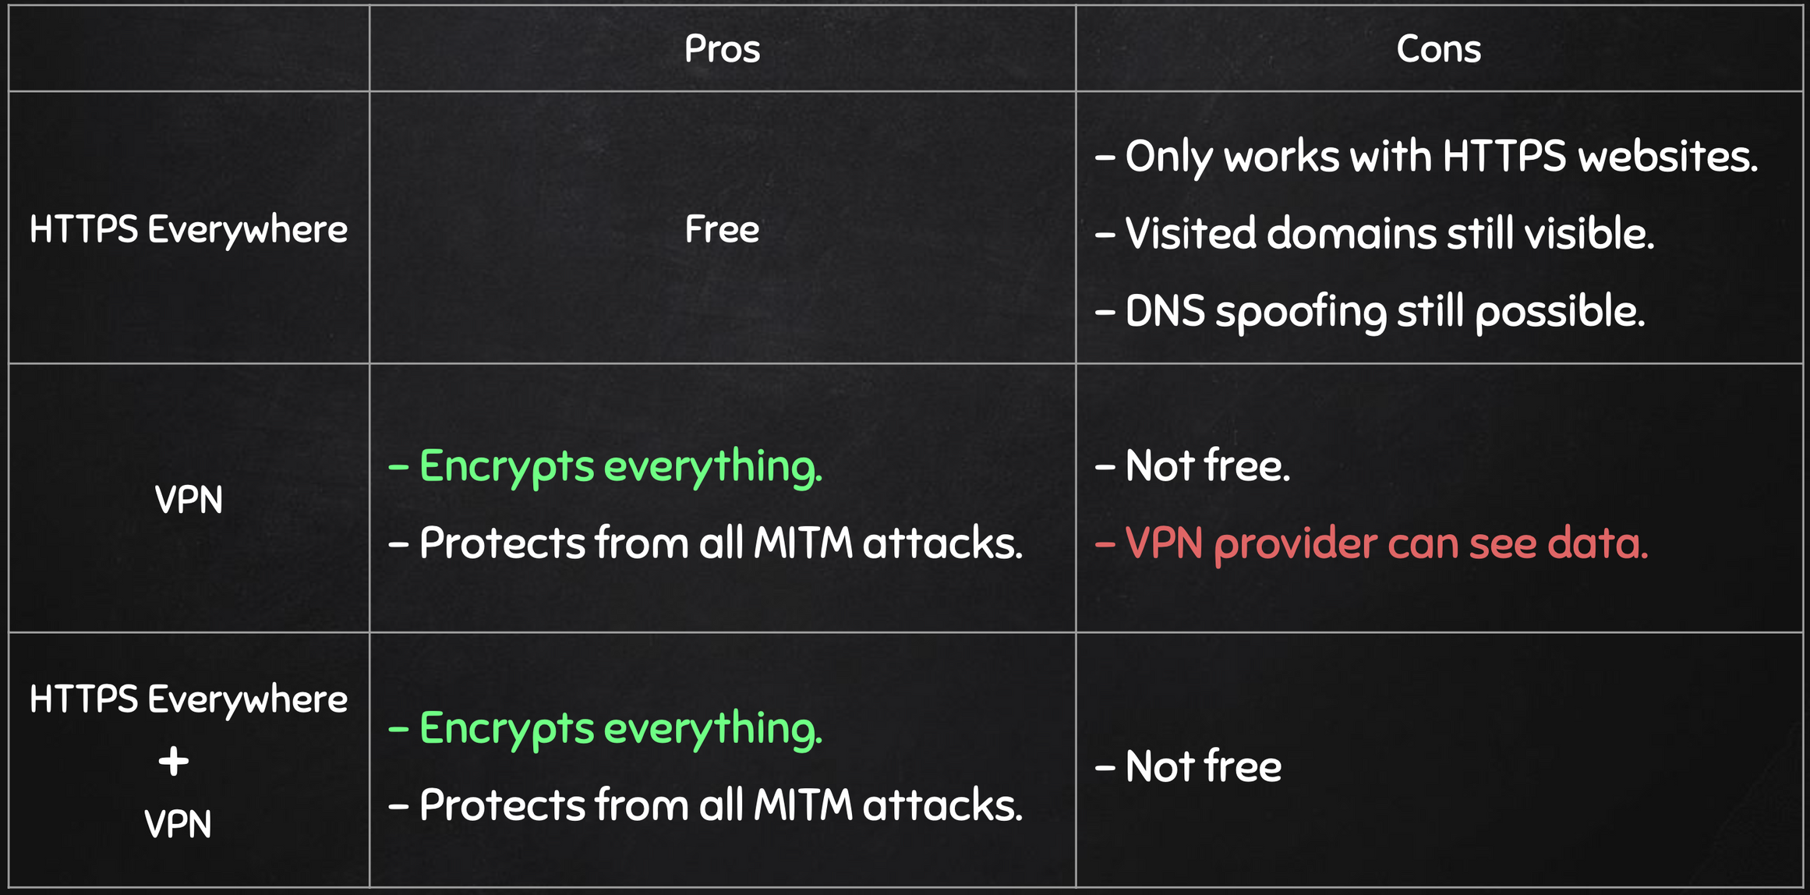
Prevention Table:

Slide 20

VPN - Virtual Private Network

Slide 21

VPN - Virtual Private Network

Slide 22
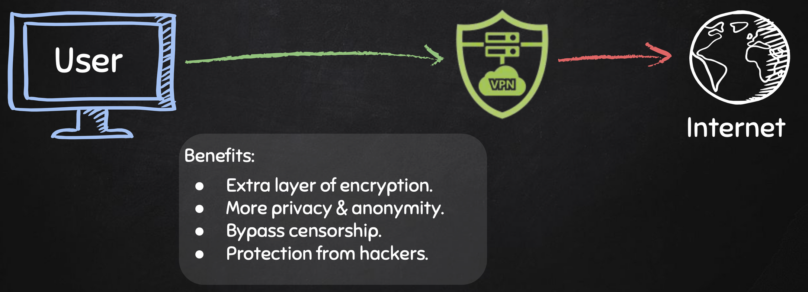
VPN - Virtual Private Network

Slide 23
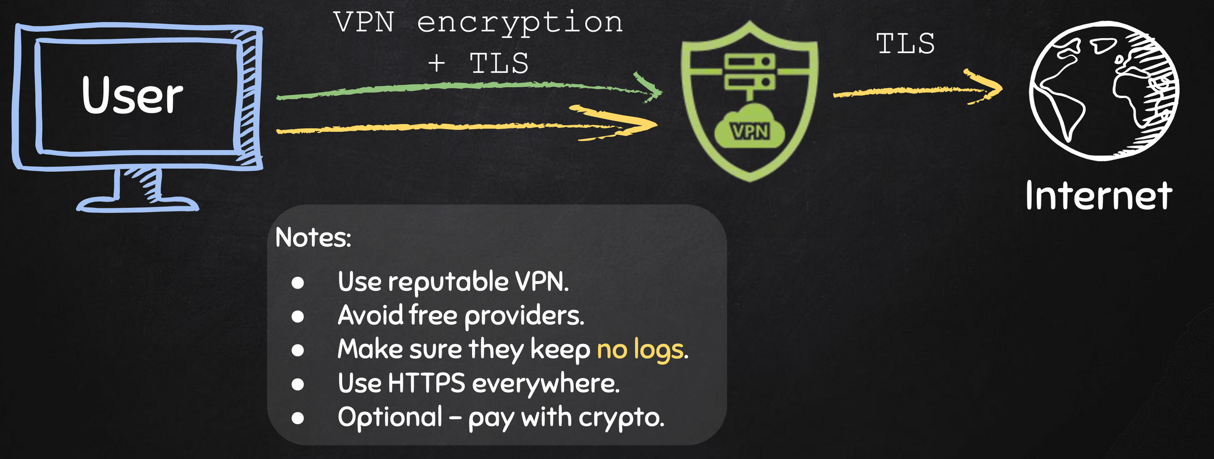
VPN - Virtual Private Network

